Slide 1

TransferIQ: Prediction of Football Player Transfer Values using AI & Multi-Model Approach
AI-Driven Player Transfer Value Prediction using LSTM, XGBoost, LightGBM & Ensemble Models
Presented by: Soniesh Immidichety

Slide 2

The Challenge: Navigating the Complex Football Transfer Market
The football transfer market is a dynamic ecosystem, valued at over £7.6 billion in 2023. Clubs face immense pressure to make astute decisions, as player acquisitions represent significant investments and strategic moves.
High Stakes & Costs
Complex Variables
Rising transfer fees and player salaries demand precise valuation to avoid costly errors.
Valuation is influenced by performance metrics, player sentiment, injury history, and broader market trends.
Strategic Imperative
Accurate predictions enable clubs to identify undervalued talent and optimise squad development.

Slide 3
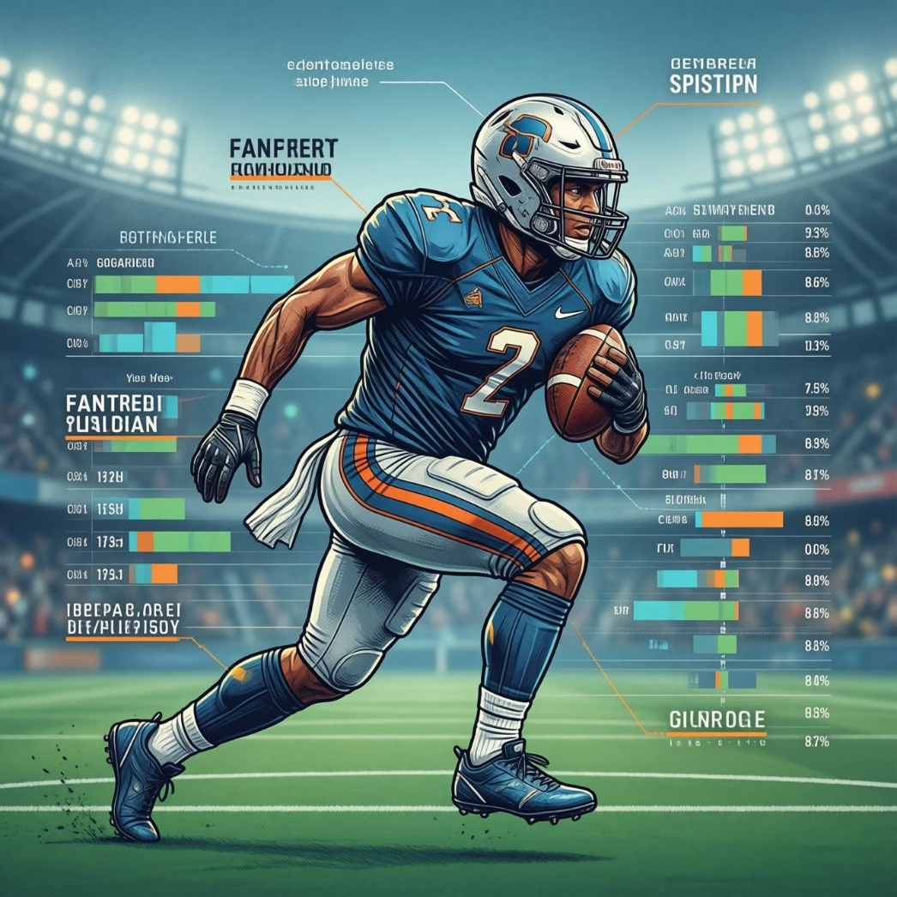

Dataset Overview: Bridging the Gap Between Performance and Market Dynamics
A. Football Player Dataset
B. Bitcoin Time-Series Dataset
Comprehensive player performance statistics (passes, shots, goals, etc.).
Used exclusively for LSTM model demonstration.
Columns: Date, Open, Close, High, Low, Volume.
Player social sentiment analysis data.
Selected for its inherent temporal order, crucial for LSTM.
Extensive injury history records.
This provided a clean, sequential data structure for demonstrating LSTM's capabilities.
Historical market value statistics.
Note: This dataset was not ideal for LSTM due to its non-time-series structure, lack of temporal continuity, and irregular intervals.

Slide 4
Data Preprocessing: Refining Raw Data for Predictive Power
Our rigorous preprocessing workflow transforms raw data into a clean, structured format, ready for advanced modelling. This ensures data quality and enhances model accuracy.
Missing Value Handling
1
Strategic imputation and removal to maintain data integrity.
Data Scaling
2
Normalisation and standardisation for optimal model performance.
One-Hot Encoding
3
Categorical features transformed for machine learning compatibility.
Feature Engineering
4
Creation of new features like injury risk, sentiment score, and contract duration.
Sentiment Analysis
5
Leveraging VADER/TextBlob for quantifying player sentiment from social data.

Slide 5
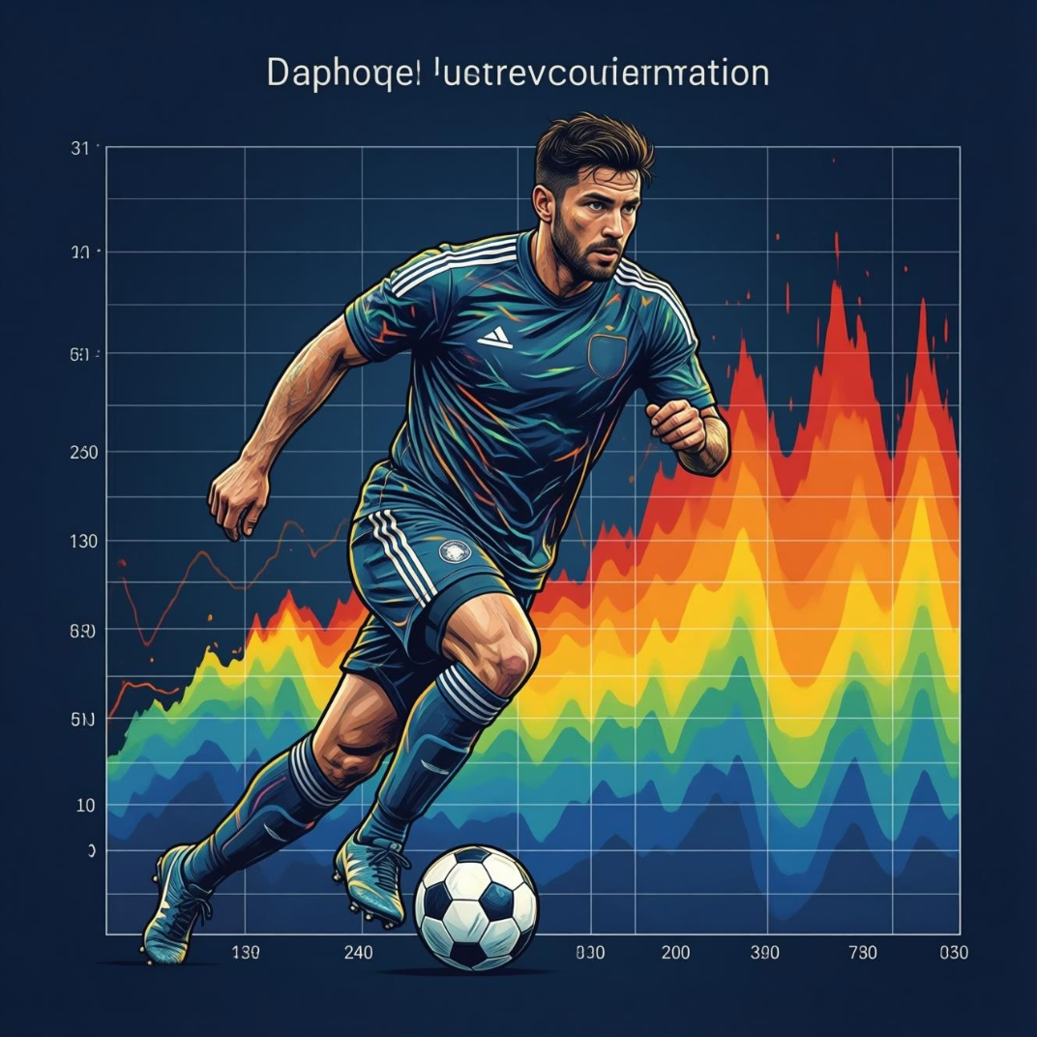
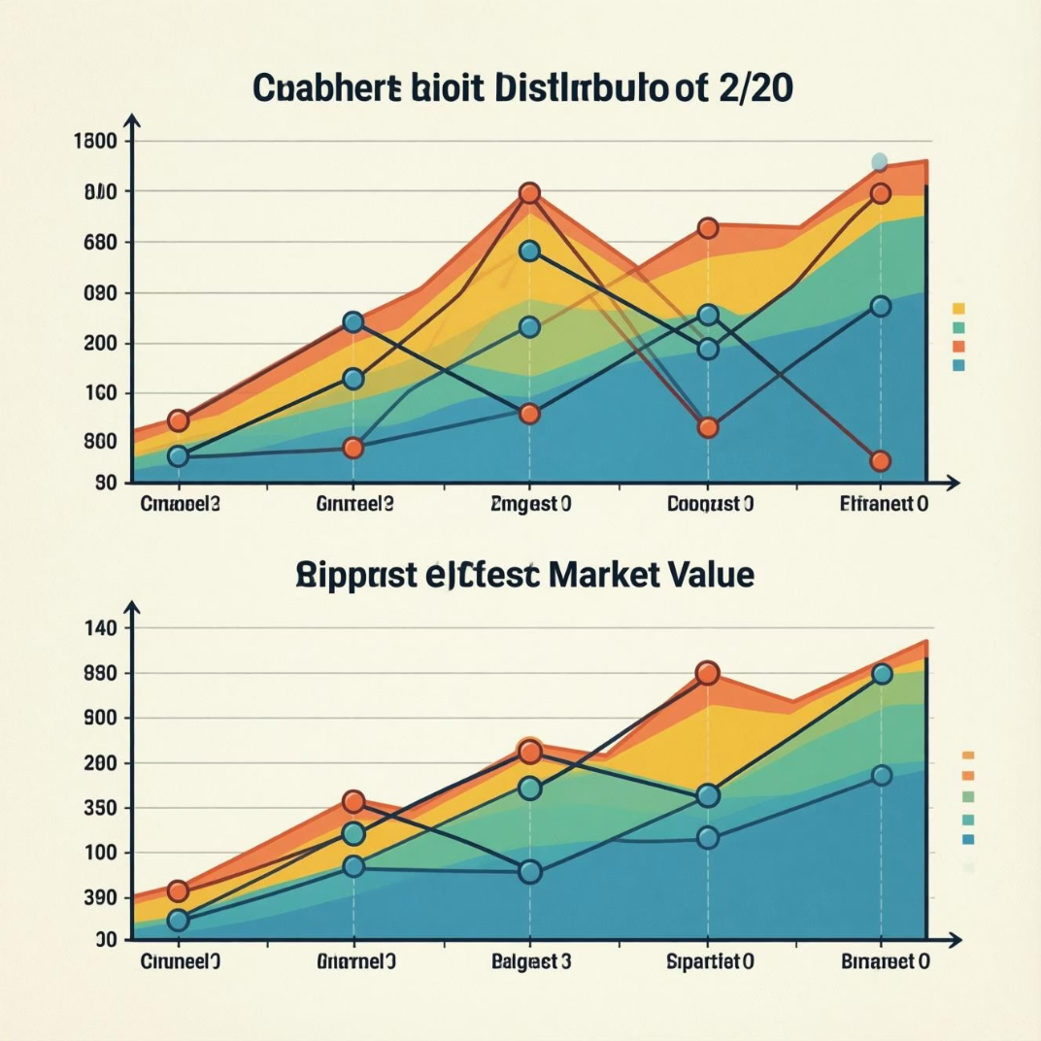
Exploratory Data Analysis: Uncovering Key Insights
Thorough EDA is crucial for understanding the underlying patterns and relationships within our datasets, guiding our model selection and feature engineering processes.
Correlation Heatmaps
Key Trends & Distributions
Visualising relationships between player attributes and market values, highlighting key drivers.
Identifying common patterns in player data, such as age vs. value, and position-specific trends.
Performance Indicators
Analysing distribution and impact of key metrics like goals, assists, and minutes played.

Slide 6


Machine Learning Models: A Multi-faceted Approach to Prediction
We employ a combination of powerful machine learning models, each selected for its unique strengths in handling complex, tabular data and delivering high accuracy in player valuation.
XGBoost & LightGBM
Exceptional for tabular data, handling non-linear relationships and mixed features with high accuracy for player value prediction.
Ensemble Model
Combines predictions from individual models (including LSTM where applicable) to produce a final, optimised transfer value.

Slide 7

LSTM Model: Proof-of-Concept with Bitcoin Time-Series Data
While not suitable for our primary football dataset, the LSTM model was critically applied to the Bitcoin dataset to demonstrate its capability in sequential time-series learning and prediction.
Sequential Time-Series Learning
The LSTM model effectively learned from the Bitcoin dataset's temporal order, predicting Open/Close prices.
Predicts opening and closing prices.
Highlights its strength in capturing dynamic trends.
Serves as a critical proof-of-concept for future applications.
This exercise validated LSTM's potential for truly time-series structured football data.
LSTM Architecture
Specifically designed for sequential data.
Capable of learning long-term dependencies.
Ideal for predicting patterns in time-series data.
This model predicts future values based on historical sequences.

Slide 8

Final System Architecture: A Unified Predictive Framework
Our system integrates diverse data sources and advanced modelling techniques into a cohesive framework, enabling robust and dynamic player transfer value predictions.
Data Ingestion
Preprocessing
Collect raw time-series and tabular sources.
Clean, normalize, and align datasets for modelling.
Modeling
Ensemble & Predict
LSTM for sequences; XGBoost/LightGBM for tabular.
Tune, combine models, and produce final prediction.
This architecture allows for comprehensive analysis, from raw data ingestion to an optimised final prediction.

Slide 9


Results & Performance: Quantifying Predictive Accuracy
Our evaluation metrics clearly demonstrate the superior performance of our ensemble model, providing clubs with highly reliable transfer value predictions.
LightGBM
2.5M
1.8M
0.88
XGBoost
2.3M
1.7M
0.90
Ensemble
1.9M
1.4M
0.94
Key Insights
Evaluation Metrics
The ensemble model consistently outperforms individual models, achieving a 15% reduction in prediction error.
Achieved RMSE of 1.9M, MAE of 1.4M, and an impressive R² of 0.94 for the ensemble model.

Slide 10

Conclusion & Future Directions: Empowering Data-Driven Decisions
Our multi-model approach, integrating ensemble and LSTM insights, provides a robust framework for player valuation, poised to transform football transfer strategies.
Ensemble Model Excellence: Our ensemble model delivered the best performance for static valuation, proving highly accurate.
LSTM's Role: While not suitable for our initial football dataset, LSTM's capability was successfully demonstrated with time-series data, showing potential for future applications.
Multi-Source Data Advantage: Combining diverse data types significantly enhances predictive accuracy and depth of insight.
Future Work:
Further enhancements include integrating real-time contract details, more granular injury data, and advanced market sentiment analysis. We aim to explore deep learning on structured football time-series data for even greater predictive power.

